Slide 1
User Analytic
User analytics is a way of analyzing user data in order to give companies a clearer view of user cohorts. Typically, a business intelligence software is used to combine customer behavior data from web and mobile applications to create a holistic view of the user and the user experience.

Slide 2
Example
Users were dropping out of the new user registration process on its portal for two reasons: Adding an extra space at the end of a name created an error message, and a third-party authentication tool was taking too long to load. The team shared that information with their development teams and the third-party partner to resolve the issues.

Slide 3

Project Description-Instagram Project- SQL
You are working with the product team of Instagram and the product manager has asked you to provide insights on the questions asked by the management team.

Slide 4
Tech-Stack Used
MySQL installer community 8.0.30.0.msi was used for this project it contains:- -MySQL Workbench 8.0 CE -MySQL Shell -MySQL Command Line Client
Installation Steps:- https://www.youtube.com/watch?v=eq-e_n7lm2M

Slide 5
Approach- I have used MY SQL Workbench which is a cross-platform, open-source, visual tool for database management. I have analyzed the database carefully. Observe all the tables, columns, rows, and relationship among all the tables and successfully created a Instagram database and Tables-Users, Photos, Comments , Likes, follows, Tags, junction table: Photos – Tags. After Inserting data into these table , Enhanced Entity-Relationship (EER) diagrams is used to provide a visual representation of the relationships among the tables in model and after that arranged the data in various queries to obtain desired output. .

Slide 6
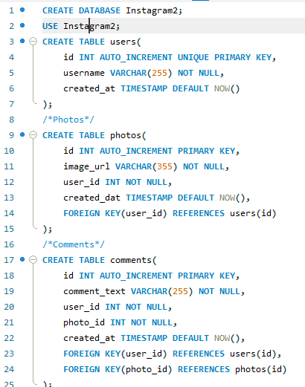
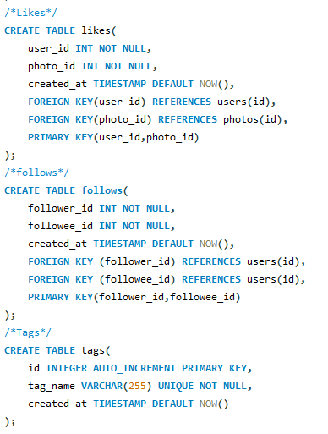
Creating a Database

Slide 7
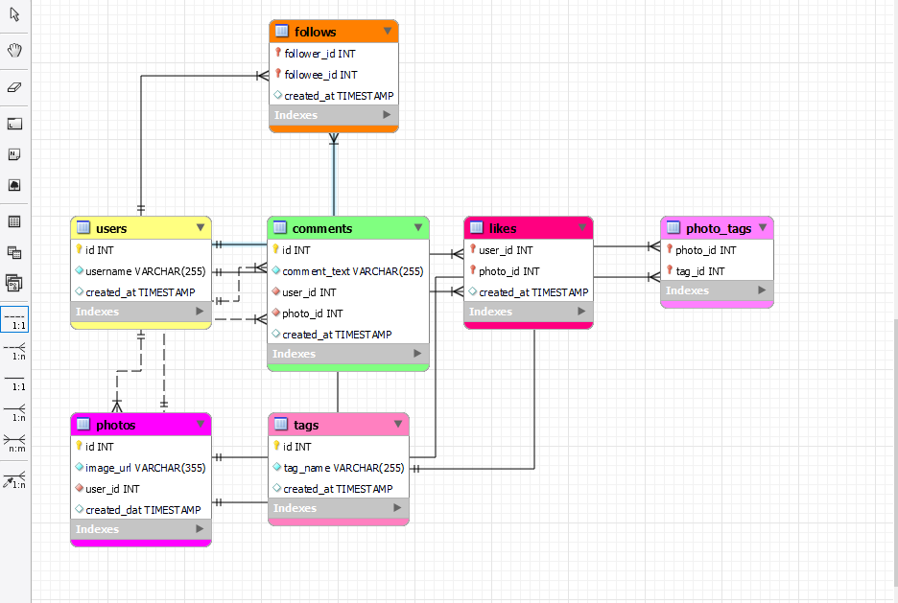
EER Diagram for project of Instagram Database

Slide 8
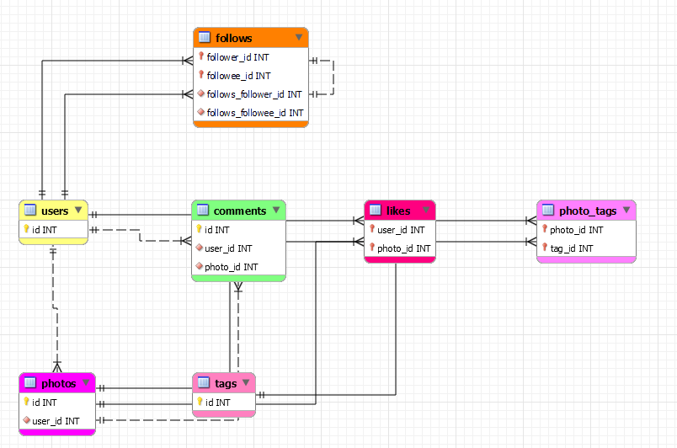
Visual representation of Primary and foreign key only

Slide 9
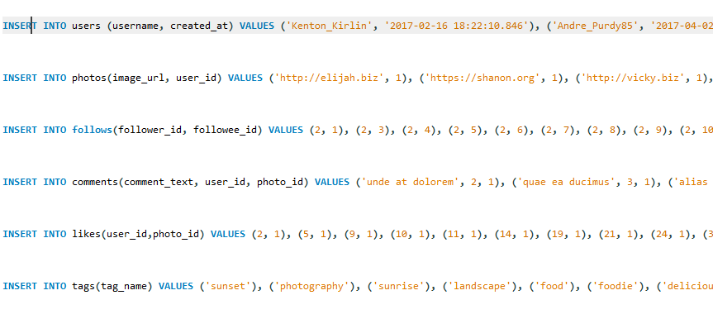
Inserting values in a Database

Slide 10
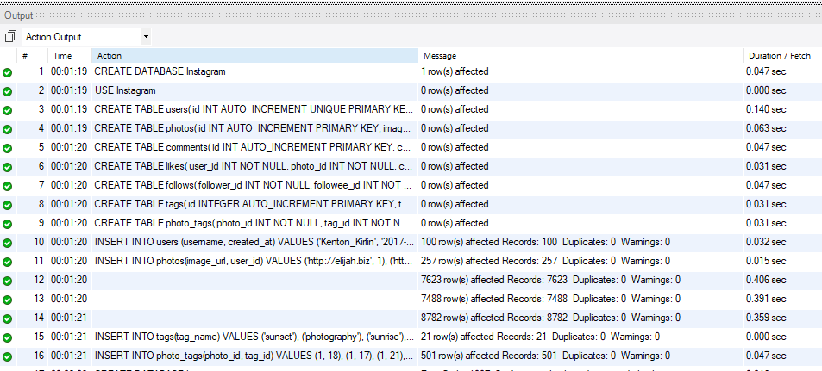
Output

Slide 11
A detailed report answering the questions below :
(1) Marketing: The marketing team wants to launch some campaigns, and they need your help with the following:-

Slide 12
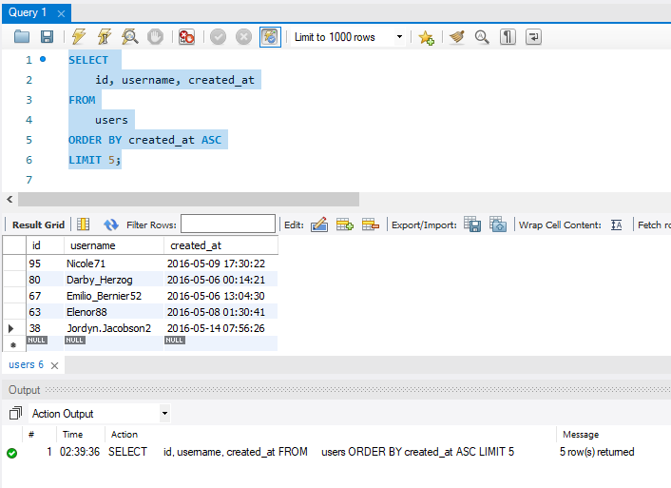
Perform Analysis: Marketing
Rewarding Most Loyal Users: People who have been using the platform for the longest time.
Task: Find the 5 oldest users of the Instagram from the database provided

Slide 13
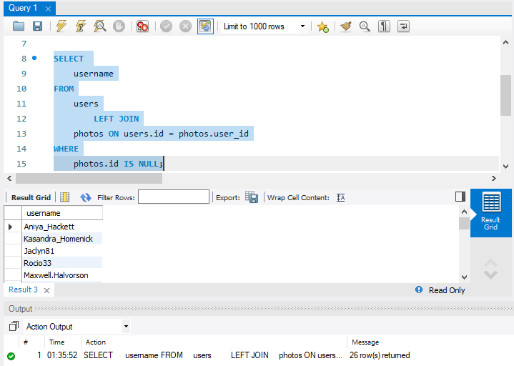
Perform Analysis: Marketing
Remind Inactive Users to Start Posting: By sending them promotional emails to post their 1st photo.
Task: Find the users who have never posted a single photo on Instagram

Slide 14
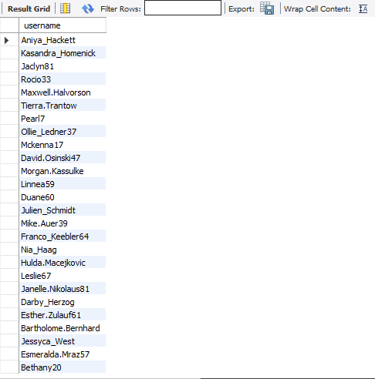
Complete User Name List: Remind Inactive Users to Start Posting

Slide 15
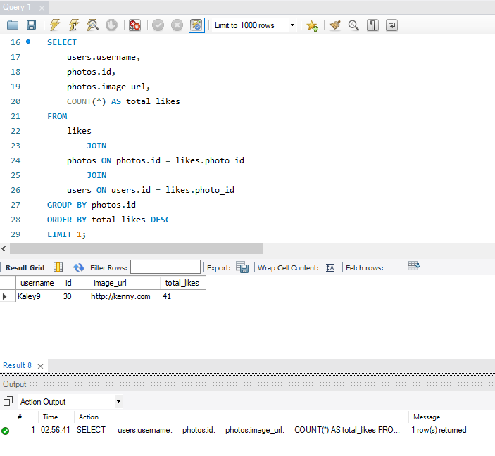
Perform Analysis: Marketing
Declaring Contest Winner: The team started a contest and the user who gets the most likes on a single photo will win the contest now they wish to declare the winner.
Task: Identify the winner of the contest and provide their details to the team

Slide 16
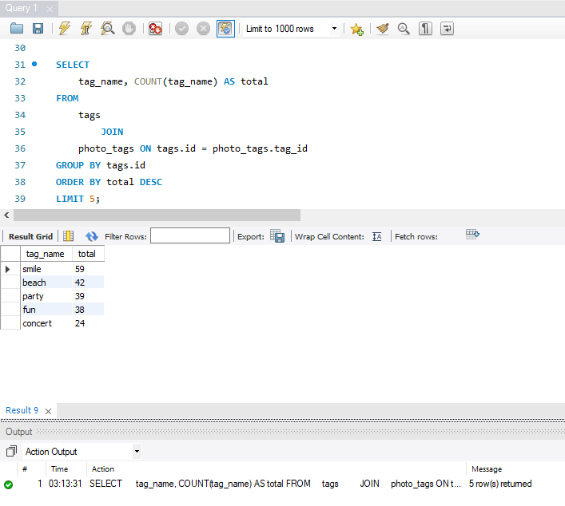
Perform Analysis: Marketing
Hashtag Researching: A partner brand wants to know, which hashtags to use in the post to reach the most people on the platform.
Task: Identify and suggest the top 5 most commonly used hashtags on the platform

Slide 17
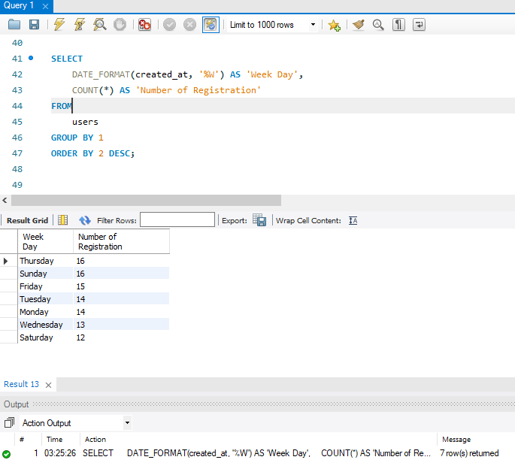
Perform Analysis: Marketing
Launch AD Campaign: The team wants to know, which day would be the best day to launch ADs.
Task: What day of the week do most users register on? Provide insights on when to schedule an ad campaign

Slide 18
(2) Investor Metrics: Our investors want to know if Instagram is performing well and is not becoming redundant like Facebook, they want to assess the app on the following grounds

Slide 19
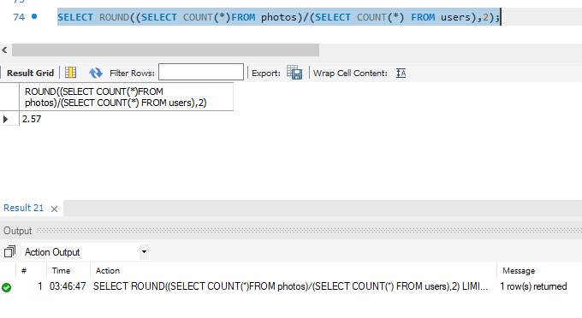
Perform Analysis: Investor Metrics:
User Engagement: Are users still as active and post on Instagram or they are making fewer posts
Task: Provide how many times does average user posts on Instagram. Also, provide the total number of photos on Instagram/total number of users

Slide 20
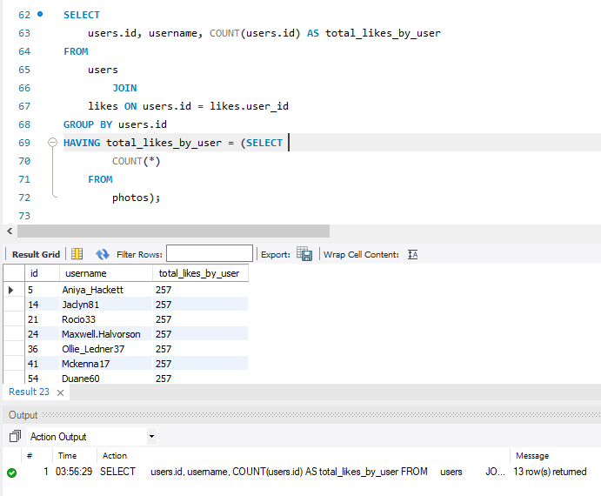
Perform Analysis: Investor Metrics:
Bots & Fake Accounts: The investors want to know if the platform is crowded with fake and dummy accounts.
Task: Provide data on users (bots) who have liked every single photo on the site (since any normal user would not be able to do this).

Slide 21
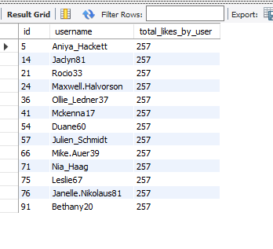
Complete User Name List: Bots & Fake Accounts

Slide 22
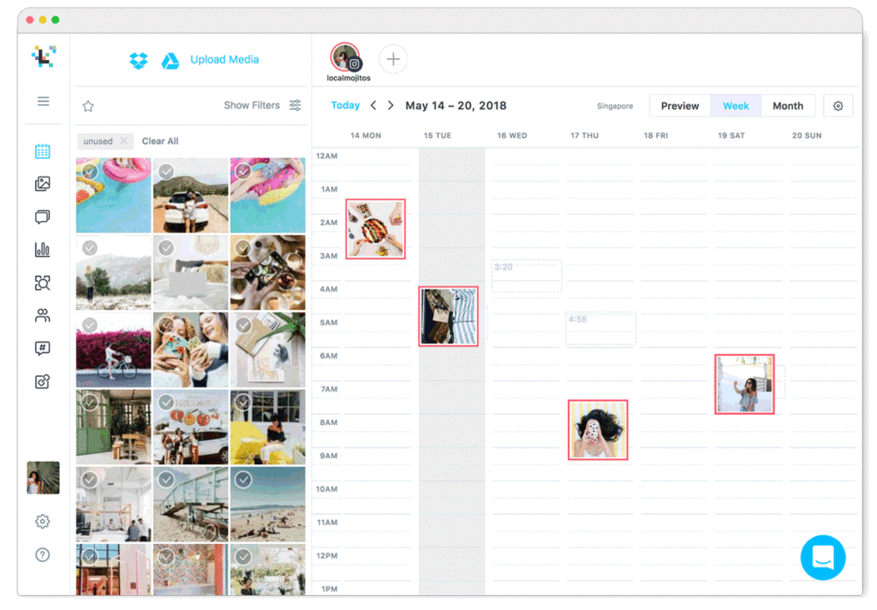
Result
I have gained knowledge of various SQL functions which helped me to solve the questions asked in this project. Following are the functions I used: Sorting functions-TOP, , GROUP BY, HAVING, ORDER BY, JOIN,LEFT JOIN
Aggregate function- COUNT

Slide 23
THANKS

